Slide 1
Data, Environment and Society (ER131) Lecture 1: Introduction
August 24, 2023
Instructor: Duncan Callaway
GSI: Colette Brown
Notes:
I’d like to begin with a brief acknowledgement of the land we are standing on: UC Berkeley sits on the territory of xučyun (Huichin / Hoochoon), the original landscape of the Chochenyo speaking Ohlone people, the successors of the sovereign Verona Band of Alameda County.
Every member of the Berkeley community benefits from the use of this land.
Yet this region also continues to be of great importance to the Muwekma Ohlone Tribe and other familial descendants of the Verona Band – and these people are flourishing members of the Berkeley and broader Bay Area communities today.
I encourage you all to learn more about the Muwekma Ohlone and their efforts to re-gain federal recognition, to preserve their culture and language and to repatriate their ancestors' remains.

Slide 2
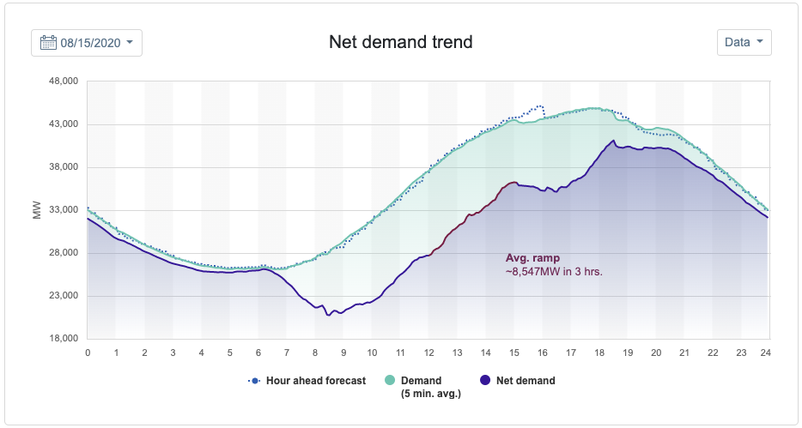
Why data, environment and society?
1. Analyzing and predicting environmental processes in time is crucial in broad cross-sections of society.
For example, as renewable electricity production grows, electric power systems must transform their operations in response
Notes:
Image source: caiso.com
Salient example: prediction algorithms are crucial for understanding whether or not to warn people we need rolling blackouts to prevent overload – as happened last year

Slide 3
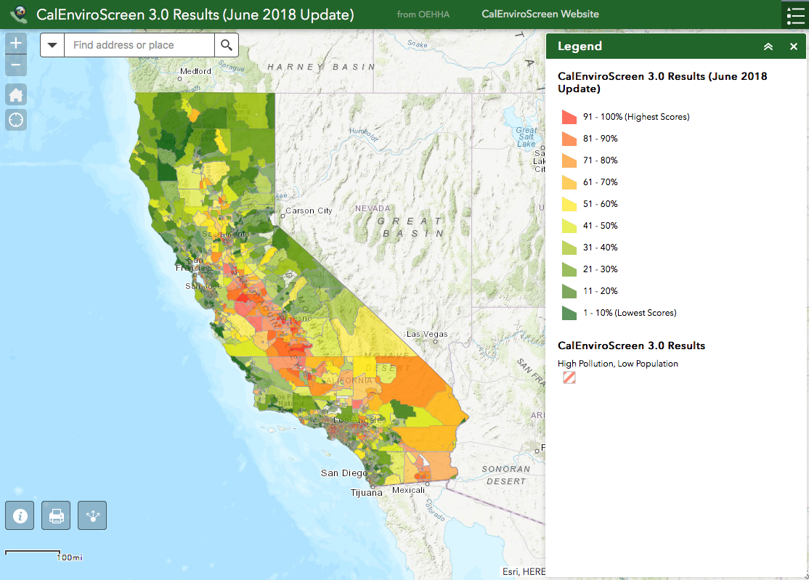
Why data, environment and society?
2. Analyzing and predicting complex phenomena across groups of people also has tremendous impacts on society.
For example, energy consumption and other industrial activities generate pollution. Its distribution and impact are heterogeneously distributed
Notes:
Pollution is heterogeneously distributed,
This map is from the Califorina enviroscreen database. https://oehha.ca.gov/calenviroscreen/report/calenviroscreen-30. We’ll work with these data in the course.
What are the implications of this?
Some people are exposed to more pollution than others
But in a more subtle way, if population demographics are heterogeneously distributed across these lines, then there is “disparate impact.”
Prediction question: Is it possible to use these data to decide where we should measure pollution more carefully? What can be done to measure and abate disparate impact?

Slide 4
Why data, environment and society?
3. There is also a need to analyze and predict complex processes in space
For example, wildfire risk assessment and smoke dispersal both follow tremendously complex rules that cannot be modeled with “first principles” models alone.
(sfgate)
(nasa)
Notes:
Question for class: What kind of data would you want to throw at a wildfire prediction problem?

Slide 5
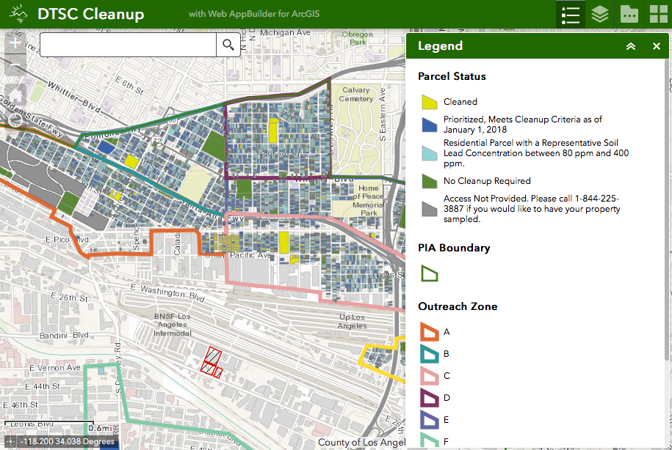

Why data, environment and society?
4. Data to study these issues is abundant and growing
Notes:
Data availability growing due to improving access and also people generating their own new data sets…

Slide 6

Why data, environment and society?
5. There is an incredible growing toolkit available to anyone with a computer…
New Algorithms
Improving computing infrastructure
New analysis tools: Jupyter, Python libraries
In sum: Prediction problems and data are abundant, the algorithms are maturing, and everything is accessible to someone with the right training

Slide 7
Quick pause
Why: Prediction problems and data are abundant, the algorithms are maturing, and everything is accessible to someone with the right training
Talk to your neighbors
Introduce yourself
Be aware if someone around you isn’t talking to someone and encourage them to join your discussion, but try to keep group sizes small
Discuss
If and how the answers to my “why” questions resonate with you
Your own objectives for the course
How your own experiences led you to take this class

Slide 8

What are the course objectives?
Teach students to build, estimate and interpret models that describe phenomena in the areas of energy & environmental decision-making.
We will
Focus on analysis and prediction
Learn a suite of data-driven modeling approaches
Build the programming and computing skills to use those models (in Python and Jupyter notebooks)
Develop the expertise to formulate questions that are appropriate for available data and models.
Students will leave the course as both critical consumers and responsible producers of data driven prediction.
Guiding principle: Learning to use data science tools in context promotes engagement and retention
Notes:
Source of image: investinghaven.com
Students have gone on to
Work for regulators (EPA)
Work in cleantech (Tesla)
Grad school – Data Science
Utilities (PG&E, SCE)
Transportation, food, energy startups

Slide 9
Who are the instructors?
Duncan Callaway (he/him)
14 years at Berkeley. Home dept = Energy and Resources Group
Teaching: Other courses include power systems, research methods, energy in buildings
Research area: Grid decarbonization
Colette Brown (she/her)
Just finished her masters in Energy and Resources and now doing a PhD
ER131 Alum from 2021
Research interests in wildfire ecology, remote sensing application for terrestrial ecology

Slide 10
A note on COVID
We’re a little less nervous than last year, but…
Consider wearing KF94 or N95 masks (no valve).
Choose one place to sit and stay there all semester –reduces mixing
Colette and I will lecture by zoom or cancel class if we are not well

Slide 11
What we’ll do for the remainder of today
Brief overview of the course
Another small group breakout
Finish early for Q&A

Slide 12
What is data science?
“Data science focuses on exploiting the modern deluge of data for prediction, exploration, understanding, and intervention”
--Blei and Smith (2017)
It is a mix of data, computing and statistics.
It is not only statistics: the algorithms have deep origins in computing and computer science
It is not only computing: one must understand the fundamentals of the origins and characteristics of data

Slide 13
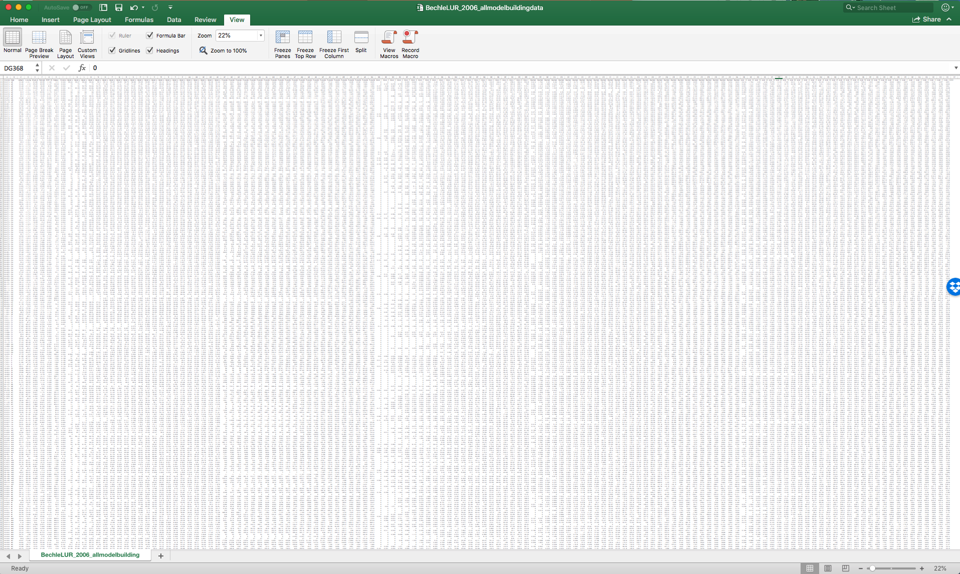
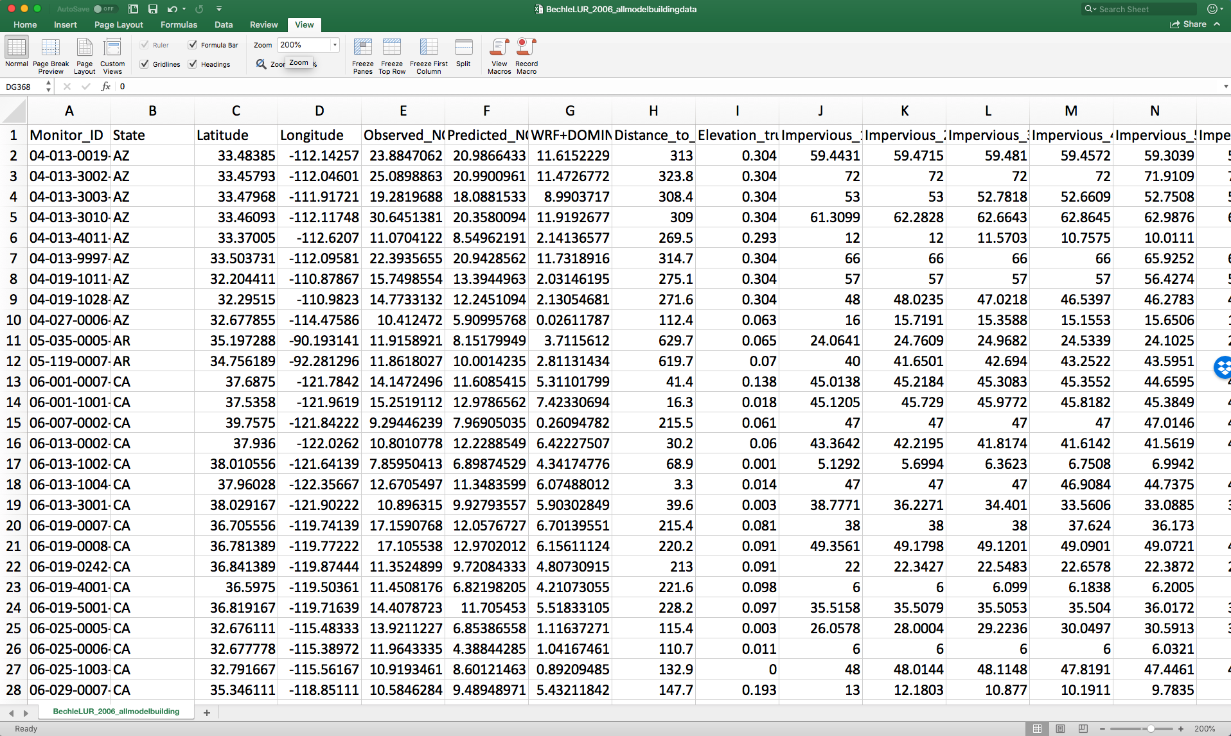
What does “big data” mean?
Two characteristics
Data sets are large (many data points in total, or cells in a spreadsheet)
Data sets are wide (many different fields, or columns in a spreadsheet)
If you can work with it in Excel, it’s not big data
Notes:
Use a poll here.

Slide 14
One translation of “big data” and “data science”
Often, big data means that we can get insight into problems that before required theoretical underpinnings
Imagine Isaac Newton as a data scientist.
Rather than working out the theory (F=ma…)
Newton could have trained a statistical “black box” model to predict the path of a projectile based on speed and direction
Notes:
Knussel’s ”pure big data” problems are those that don’t use any theory (like the black box model)
In this sense, big data problems are those where we care only about the prediction, and not about the underlying causal forces.

Slide 15
Central theme of the course: using prediction methods in support of resource allocation decisions
Let’s unpack this a little further…

Slide 16
What can we do with data science? Cloud seeding vs. Umbrellas
(adapted from Kleinberg AER 2017)
Consider two policy makers studying rain
One seeks to understand if cloud seeding will make it rain
One seeks to decide whether or not to invest in umbrellas
Both require models and data, the analyses are qualitatively different. Why?
“Cloud seeding” problems are impact analyses. The seek to identify a causal effect via inference.
We call “umbrella” problems resource allocation problems. They seek to predict the future so people can decide where to allocate resources and effort.
(amazon.com)

Slide 17
Inference (cloud seeding) versus prediction (umbrellas)
Resource allocation
Where, for whom, or when should I use limited money, people, and time to solve a problem?
Prediction
Produces data you can’t directly measure
Who, where, when?
Inference
Measures the effect of one variable on another
How, why?
Impact analysis
Did my efforts work?
Is it a good idea to keep doing what I’ve been doing?

Slide 18
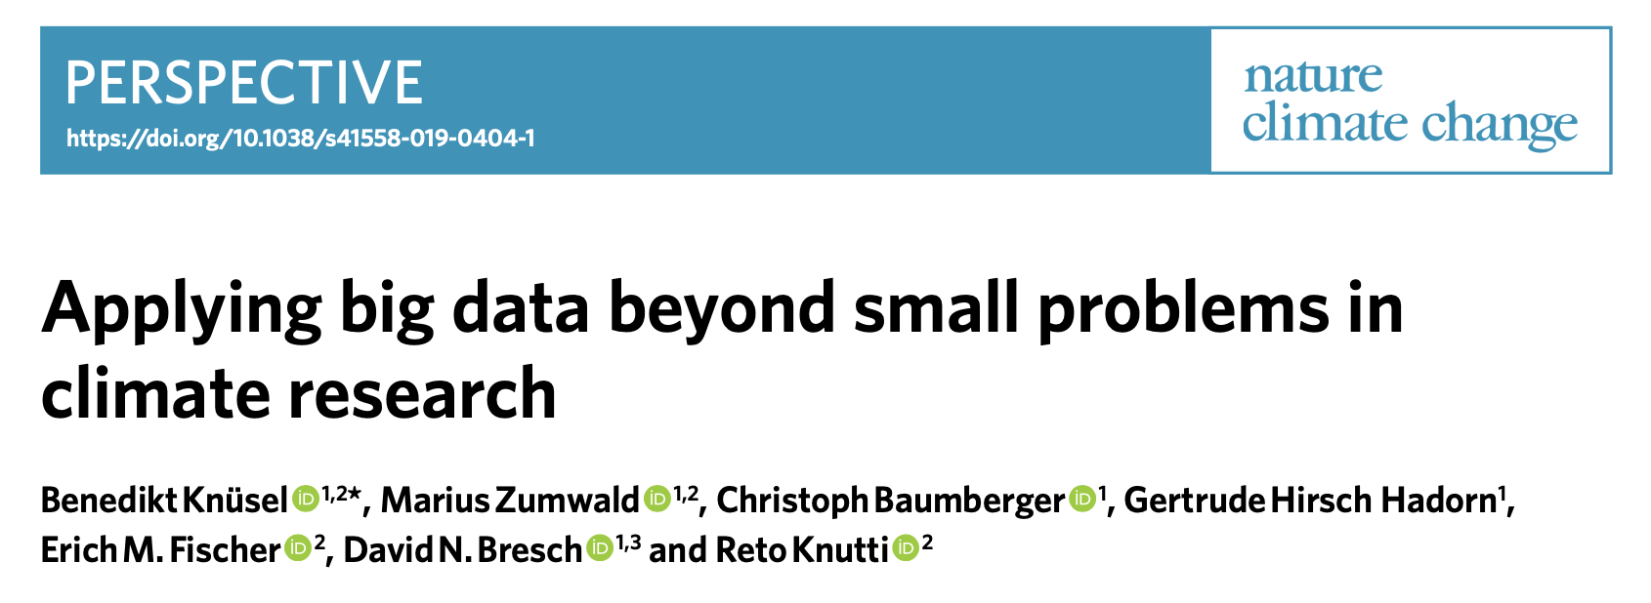
To do prediction right:
The system is predictable for the questions of interest
You have enough data to train the model
You have enough data to periodically evaluate the predictions and make adjustments

Slide 19
The models we study in this course are good for prediction We’ll focus on using them to answer resource allocation problems

Slide 20
Quick pause
Talk to another neighbor
Introduce yourself
be aware if someone around you isn’t talking to someone and encourage them to join your discussion, but try to keep group sizes small
Discuss
Brainstorm a few ideas for prediction problems
Brainstorm a few ideas for the connected resource allocation problem
I’ll have some of you volunteer a summary of the things you discussed
It can be hard to get it right here – mistakes in scoping prediction problems are ok!

Slide 21
Some of my resource allocation examples
Time, money and people (resources) are usually scarce
Prediction models can be used to help decide how to use those resources
Where should I send facility inspectors?
Where should we put EV chargers?
Where do we need more air pollution monitors?
Who is at risk for heart disease?
When should I start charging my battery?
When will solar power output peak?
Notice that we are not asking “how” or “why” questions – those are the domain of inference.

Slide 22
The importance of context and narratives
From Pastor’s 2007 article in Reclaiming Nature on Environmental Justice (EJ):
Some favor “…’rational’ processes of debate, objective scientific research on hazards and their risks…such frameworks tend to produce negotiation between businesses and their hired experts…”
Others favor “…‘democratic’ epistemologies in which community participation facilitates story-telling about lived experiences…in the minds of many…this allows for community empowerment.”
Which do you prefer?
Notes:
“rational” processes:
when done right, can have greater objectivity. They promote science based decision making.
when done wrong, they exclude vulnerable populations without access to data or training. The people impacted by the polluting activity can’t get a seat at the decision making table.
“democratic” epistemologies on the other hand
facilitate engagement by those affected by pollution.
lack the credibility of the ”rational” process.
However they enable people to capture factors that science can’t – for example anecdotes about what it means to grow up in the shadow of a refinery.
THIS COURSE WORKS IN PURSUIT OF AN IDEAL IN WHICH THESE PARADIGMS ARE NO LONGER SEPARATE. Widespread availability of data and analytical tools – what we leverage in this course – generate opportunities for communities to engage in the scientific debate.

Slide 23
Recap – key concepts
Big data: many observations, and many features per observation
Prediction versus causal inference (y versus β)
Prediction models are used to support resource allocation decisions
The importance of context and narratives

Slide 24
Now let’s go into the nuts and bolts of the course These details are all available on the “syllabus” pdf in the files section of the course bCourses site.

Slide 25
Inclusion in the classroom
We are committed to creating a learning environment welcoming of all students
If you have a name and/or set of pronouns that differ from those that appear in your official records, please let us know.
If you feel like your performance in the class is being impacted by your experiences outside of class (e.g., family matters, current events), please don’t hesitate to come and talk with us. We want to be resources for you.
We (like many people) are still in the process of learning about diverse perspectives and identities. If something was said in class (by anyone) that made you feel uncomfortable, please talk to us about it.
As a participant in this class, recognize that you can be proactive about making other students feel included and respected.

Slide 26
Prerequisites
(required) Foundations of Data Science (CS/ INFO/ STAT C8)
Talk with me if you have another statistics course
(recommended) Computing: An introductory programming course (CS61A or CS88).
This or an equivalent is required if you haven’t taken Data 8.
Math:
(required) High school or college calculus.
(recommended) Linear Algebra (Math 54, EE 16a, or Stat89a).

Slide 27
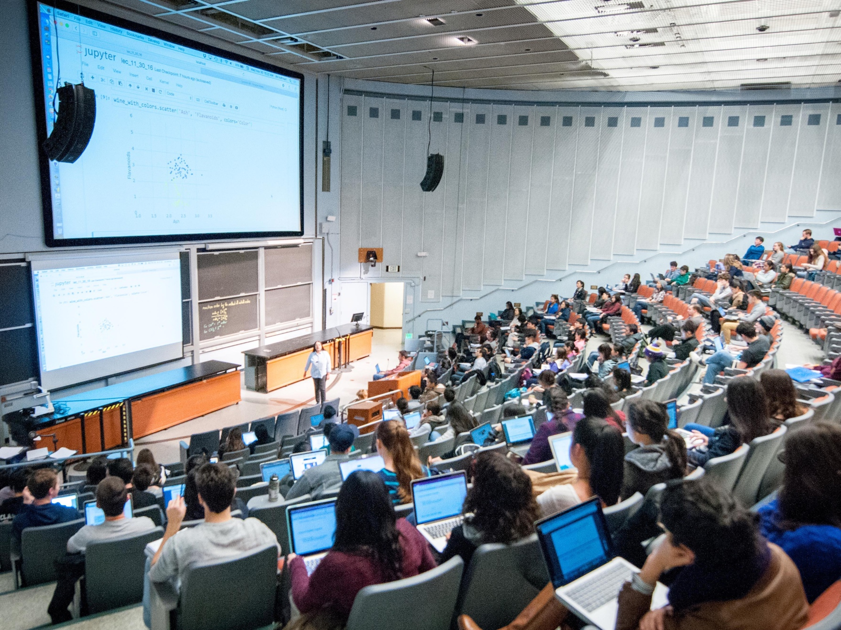
How does this course fit into Berkeley’s curriculum?
The course is designed to fit into Berkeley’s data science curriculum. It complements DS100
But we will place a stronger emphasis on how to use prediction methods as decision-making tools in energy and environment contexts
It has less emphasis on web technologies, working with text, databases and statistical inference.
The course satisfies:
Upper division domain emphasis for Data Science major
Engineering Elective for Energy Engineering
Upper division requirement for Energy and Resources Group minor

Slide 28
Some of the specific tools we’ll learn
Prediction methods
Python, Pandas and scikit-learn
Exploratory data analysis
Visualization
Gradient descent
Shrinkage methods
(wikimedia)
Support vector machines
(Wikimedia)
K nearest neighbors
(wikimedia)
Classification and regression trees
(researchgate.net)
Neural networks
(wikimedia)

Slide 29
What resources are required?
Hardware: You’ll need a laptop.
Mac, Windows, Linux, Chromebook all ok.
If you don’t have a laptop please email me or Colette after class.
Bring your machine to labs! And we’ll occasionally use them in lecture.
Internet connection
Software:
Computing:
All work can be done in the cloud, on Berkeley’s datahub
If you wish, you can install Python locally with Anaconda; we’ll use Python 3.x
…but we won’t troubleshoot your local install – work in Datahub before asking questions
Read-ware:
Introduction to Statistical Learning, available as PDF or for sale from online retailers.
Other reading will be distributed through bCourses.

Slide 30
How are students evaluated?
Labs (10%). Submission by submitting pdf of Jupyter notebook. 9 assignments, we drop the one lowest grade.
Homework (30%). Submission as Jupyter notebook (ipynb and pdf). 10 assignments, we drop the two lowest grades.
Quizzes, about 6, every other week, we drop the lowest grade (10%)
Mid term (15%)
Final project (35%)
Note: there are no attendance or participation grades. This is so you’re not penalized for staying home when you feel unwell.

Slide 31
Evaluation, ctd
Labs:
Grading will focus on completeness rather than correctness.
Final project:
Proposal presentation, 3% of total course grade (Nov 7-8, in lab)
Peer comment on three proposal presentations, 2% (due Nov 14)
Final Presentation during exam session, 5% (Dec 14 3-6p)
Final notebook, 25% (Dec 15)

Slide 32
Weekly logistics
Each week we’ll do a combination of labs, homework, reading discussion, lecture…
It’s a lot to keep track of!
We’ll send a message via bCourses at the beginning of each week with everything that’s happening for the next two weeks
We are also setting up an Ed Discussions site, and will moderate discussion on homeworks, etc. there.

Slide 33
Working in groups and with AI assistants
Homework and labs
Brainstorm together!
However: the work you submit must clearly be your own. Be sure to finish assignments on your own. Comments and markdown cells must clearly be your own.
We will not assign you into groups. Email us if you are looking for group-mates and we’ll keep a list and match-make when practical.
We treat AI-based assistants as we do collaboration with others in class: chat about ideas, brainstorm.
Quizzes and exam: you may not work together
Final project
We will assemble groups of 4 for the final project
Work you submit must be your own
Notes:
Final project: . The final project writeup must include a statement describing each team member’s contributions and a statement that all team members agreed the division of labor was equitable.

Slide 34
WORK YOU SUBMIT MUST BE YOUR OWN
Submitting anything you did not write (or code) in your assignments is academic misconduct
If we are concerned that you have violated this policy, and you refute that concern, we will refer the case to the Berkeley Center for Student Conduct

Slide 35
Useful practices for working with AI assistants (credit to David Joyner at GA Tech)
Never hit “copy” within your conversations with AI
Never have your assignment and the AI agent open at the same time
…and keep in mind that we will refer any cases of concern to the Berkeley Center for Student Conduct

Slide 36
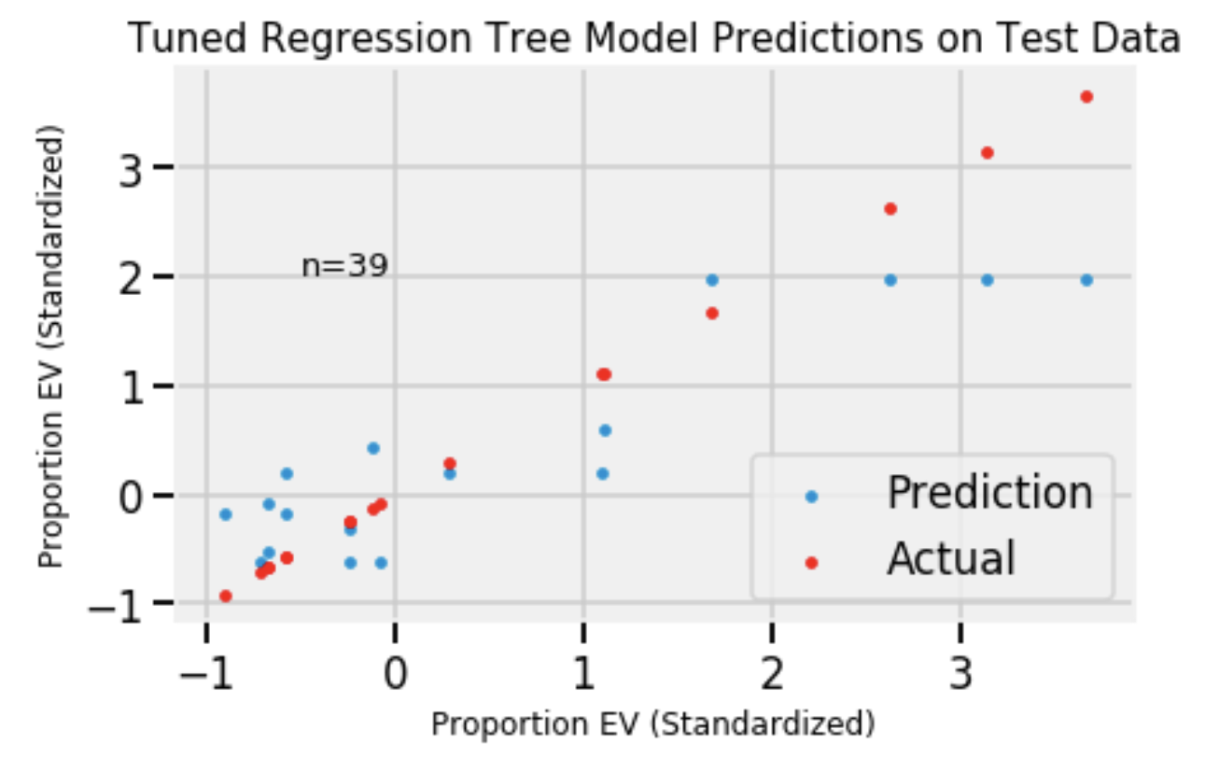
A bit more on the final project
We’ll get started on the project in September
You’ll propose your final project ideas in November
Poster session on final exam day: Dec 13 3-6p
(there is no final exam; the project is your final.)
Example project: Predict what fraction
of registered cars in a census block are EVs

Slide 37
When?
Lectures: Tu/Th 5-6:30p
Labs: Tu 3-5, We 11-1 (bring your laptop)
Office hours (links in weekly announcements and bCourses)
Duncan: Thu 4-5, before class in 337 Giannini, walk to lecture
Colette: Tue 2-3, Weds 1-1:30, 5 Giannini
Lab notebooks due Tuesdays
HW notebooks due Thursdays

Slide 38
Q&A

